Slide 1
CARDS
AGAINST
TELEGRAM
A MOBILE-FRIENDLY
PARTY GAME FOR HORRIBLE PEOPLE
BY HORRIBLE PEOPLE
Team 03:
Sagar Patel Amir Omidi Jessica Hoban Balaji Lakshmanan Tanfe Aderemi
Notes:
Team 03

Slide 2
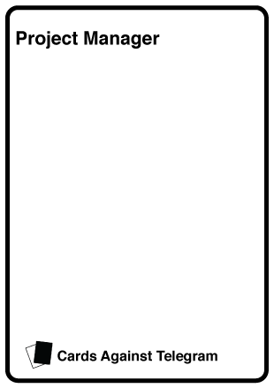
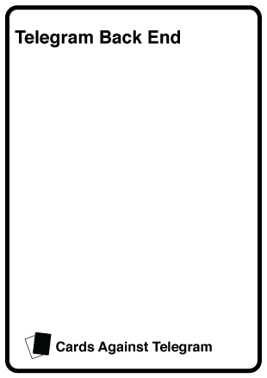
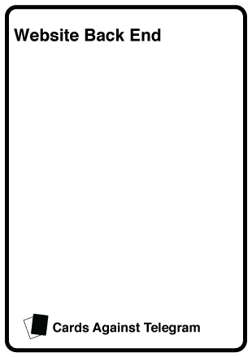

THE TEAM
CONSISTS OF?
Notes:
Jess

Slide 3
OUR PROBLEM STATEMENT?
TELEGRAM IS A WIDELY POPULAR COMMUNICATION PLATFORM WITH GREAT CAPABILITIES
THERE ARE CLASSIC VARIETY GAMES FOR TELEGRAM SUCH AS CHECKERS AND ROCK, PAPER, SCISSORS
WE AIM TO TAKE ADVANTAGE OF THE TELEGRAM PLATFORM TO CREATE FUN, MEMORABLE EXPERIENCES FOR USERS
Notes:
Amir

Slide 4
WE’RE
MAKING:
A Telegram bot, created using Telegram’s API.
This bot will create a multiplayer platform to play Cards against Humanity with friends who use Telegram.
Notes:
Sagar

Slide 5
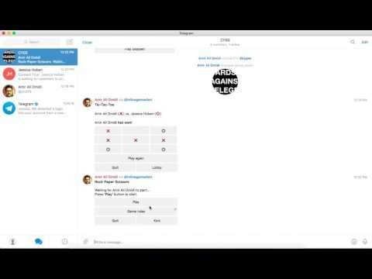
Notes:
Jess

Slide 6
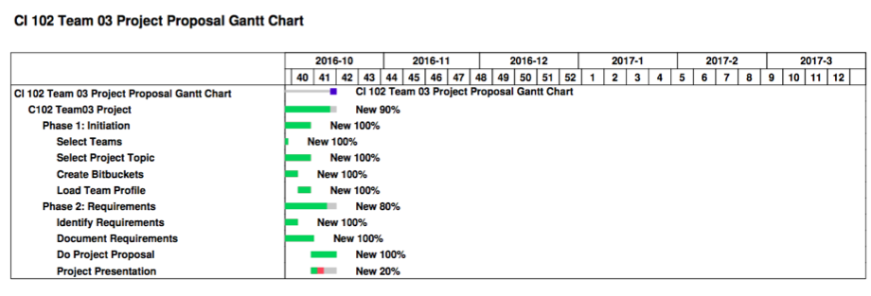
WHAT DOES THE PROJECT SCOPE LOOK LIKE?
Agile methodology
Notes:
Sagar

Slide 7
AND OUR PROJECT ACTIVITIES?
Weekly huddles
Update Gantt chart and Bitbucket account every week
Connect website backend to Telegram backend
Notes:
Tanfe

Slide 8
WHAT TECH ARE WE USING?
PROGRAMMING LANGUAGES & FRAMEWORKS
JAVA
REDIS (KEY->VALUE, PUBSUB)
PYTHON
FLASK
HTML
CSS
JS (AngularJS)
Notes:
Amir/Sagar

Slide 9
WHAT TECH ARE WE USING?
TOOLS
GIT
MAVEN
LOMBOK
Notes:
Amir

Slide 10
WHAT CHALLENGES ARE WE FACING?
LEARNING THE TELEGRAM API
LEARNING REDIS
BUILDING A DATABASE TO RECORD USERS SCORES
Notes:
Tanfe

